Slide 1

Note on C
C is a high-level programming language
C++ is a popular extension, enhanced with dynamic structures
C files are suffixed with a .c
C is a compiled language (opposed to interpreted)
Pros and cons of this aspect ?
There are several existing C compilers (gcc, xlc, icc, …)
Could you imagine why ?
C is very powerful because
OS operations can be issued from the C code
We can « play » with hardware ressources from the code
Third party libraries can be called from the code
Various tricks can help to drastically improve the performance of the code
Numerous precompiling features
C offers lot of flexibility
Automatic casting at runtime (be careful!)
Pros and cons of this aspect ?
We can allocate and release ressources dynamically
Examples ?
We can generate a library from our code, thus making it available to others.
Examples ?
Possibility to manipulate and insert assembly codes
http://www.hemisphere-education.com/cours/s1825/part_s1825.pdf ou .pptx

Slide 2
Note on C
Generic Structure of a C program
//include a header or another c code file
#include <filename> //the file is located in a recorded directory
#include path/filename //path is not in the list of predefined paths
#define token expression //each occurrence of token will be replaced by expression
int global_integer; //I can use global_integer everywhere
void routine(){ //one of my routines (optional)
}
int main(int argc, char **argv){ //the main routine (mandatory)
//argc is the number of parameters passed by the user when running the program
//argv is the list of parameters (it is an array of « strings »)
//argv[0] is the command used to launch the program
return 0;
}
Why do we need to include header files ?
When is it useful to include another .c file ? Do you see any potential conflict ?
Give some nice example of #define. Comment pros and cons of #define.
if I do ./myprogram.exe 4 file.dat 0.03 , what are the values of argc and argv ?
Since argv contains strings, how can I get other type of values ?

Slide 3
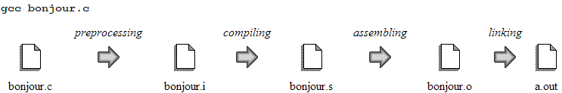
Note on C
Compilation
compiler [options] input_filename [output_filename]
compiler = gcc, icc, xlc, …
options = -E, -O, -O3, -O5, -S, -o, …
Intermediate files are automatically deleted
Use appropriate option to stop the chain to the expected target file (-E: .i; -S: .s; -c: .o )
-Ox option is used for performance
For a given machine, it is better to use its specific compiler
Do you thing different C compilers will generated the same output ? Why ?
Do you think the target architecture has any influence on the compiler outputs ?
Is it always good to use the maximum –Ox option (because we want the fastest code) ?
Could you explain the content of each intermediate file ? Use a library in my code?

Slide 4
Note on C
C atomic datatype
C structured datatype
Type
signed char
unsigned char
short
unsigned short
int
unsigned int
long
unsigned long
signed long long
unsigned long long
float
double
struct MyStructure {
int age;
char gender;
char name[20];
float AverageMark;
struct AnotherStructure StructBis;
};
a finite list of fields
each field is of an atomic type or structured type
Example:
struct MyStructure MyVar ;
MyVar.age = 18;
The size of a data type is obtained using the sizeof() function (e.g. sizeof(long);).
Do you think that the size of data types depends on the machine ? Explain
Give a structure for matrices and for complex numbers
Array of structures vs structure of arrays.

Slide 5
Note on C
Special operations
bitwise operations
Examples ?
right shift (>>) and left shift (<<)
bitwise AND (&) bitwise exclusive OR (^) bitwise inclusive OR (|)
Examples ?
Operation assignment += -= *= /= %= <<= >>= &= % = modulo
Pointer and Dynamic allocation
A pointer is an address variable over a given type e.g. int *p; struct strucdef *p;
int p; &p is the address of p int *p; *p is the value contained at address p
malloc(N) allocates N bytes e.g. int *p; p = malloc(N*sizeof(int));
free(p) desallocates or free the memory referenced by p
What if we forget to do it ?
NULL is for an empty pointer (use this value to test successful malloc)
I/O
FILE *fp ; fp = fopen (“filename”, “r/w”); fclose(fp);
fread(const void *ptr, size_t size, size_t nmemb, FILE *fp);
fwrite(const void *ptr, size_t size, size_t nmemb, FILE *fp);
char ch; char *str; ch = fgetc ( fp ) ; fputc(ch); fputs(str);

Slide 6

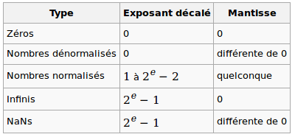
Floating Point Representation (32-bit word/simple precision)
(-1)^{s} x (1. + M) x 2^{E-Bias}
S E M
The sign
A binary digit, 0 means postive number and 1 means negative number
The exponent
Represented with 8 bits using a biased binary notation (instead of signed 2’s complement)
The bias for the IEEE 8-bit exponent is 127 (2⁸-1)
The range of exponents representable if from -126 to 127 (E from 1 to 254, always positive)
The exponents 000…0 and 111…1 are special (will be explained later!)
A larger exponent field mean implies a wider range of representable values (64-bit word)
The mantissa (or the significand)
Represented with 23 bits using a normalized notation (of the form 1.mantissa, 1. is implicit)
The normalization is also useful to have a unique representation for each FP number
A larger mantissa field mean implies a higher precision for the representation (64-bit word)
Example: 1 00111111 00100000000000000000000
Sign: -
Exponent: 63 – 127 = - 64 ( bias = 127 ! )
Mantissa: 1.001 = 1.125
Decimal value: - 1.125 x 2⁻⁶⁴ = - 6.099 x 10⁻²⁰
Special cases
Exponent 000…0 is for 0 (m = 0) or for a denormalized representation (m ≠ 0)
Exponent 111…1 is for infinity (m = 0) or a NaN = Not a Number (m ≠ 0)

Slide 7
Double precision on a 64-bit machine
 | Encoding | Sign | Exponent | Bias | Mantissa
Simple precision | 32 bits | 1 bit | 8 bits | 127 | 23 bits
Double precision | 64 bits | 1 bit | 11 bits | 1023 | 52 bits
Example:
-0.3125
-0.3125₁₀ = -0.0101₂ = -1.01₂ x 2⁻² = -1.01₂ x 2¹²⁵⁻¹²⁷
78.25
78.25₁₀ = -1001110.01₂ = -1.00111001 x 2^{6 ( = 133 – 127)}
125
1 | 01111101 | 01000000000000000000000
127 + 6
0 | 10000101 | 00111001000000000000000
Exercise:
Give or discuss the decimal value of the following representations:
(a) 0 10111111 01100000000000000000010 (b) 1 00000000 10000000000000000000001
(c) 0 11111111 00000000000000000000000 (d) 0 11111111 00000000000000000000001
Explain how the exponent is related to the amplitude and the mantissa to the precision of the representation.
With the IEEE FP representation, can we compare two FP number on a binary basis ?
Comments on basic arithmetic operation with the IEEE representation (start with the product of two numbers).
Are there some decimals that cannot be represented exactly Write a C code that gives the FP representation. 0.1+0.9
Give some examples of basic floating point operations that will provide erroneous results and explain.
Give an example of two well represented numbers x, y (x ≠ y) such that x – y gives 0 (sizes matissa: p; exponent q).
On a 32-bit machine, explain how the compiler can deal with double precision numbers.

Slide 8
Endianness
Data storage into memory
Data are stored into the memory by chunk of 8 bits (byte). I will sometimes say that memory
is byte-addresseable. For a given word (always represented by one or a contiguous group of
bytes), the order in which its bytes are stored is called the endianness.
Big Endian
In big endian, you store the most significant byte in the smallest address (leftmost to rightmost).
With big endian, data are stored into the memory and the registers in the same manner .
Big endian addressing is encountered on IBM machines (for instance).
Little Endian
In little endian, you store the least significant byte in the smallest address (rightmost to leftmost)
With little endian, data are stored into the memory and the registers in the reverse manner .
Little endian addressing is used on INTEL machines (for instance).
Important facts ?
Data are stored the same way into the registers (does not depend on the endianness).
Data are written into the files following the endianness.
Programs that rely on the endianness will suffer from portability issues.
Why and when do we care about endianness ?
The endianness is generally seamless to the programmer on basic computations
When reading binary data from files, the endianness could be the culprit of wrong values Accessing part of a single data through a pointer should be done carefully
Exercise:
Is the endianness hardware dependent or system dependent ?.
Explain one way to detect the endianness of a given machine.

Slide 9
Detect the endianness and correct data
unsigned int endian()
{
/* Check the endianess of the machine 0: little endian 1: big endian */
long x = 0x34333231;
char *y = (char *) &x;
unsigned int ind = 0;
if(strncmp(y,"1234",4))
ind = 1; // printf("Big Endian");
else
ind = 0; // printf("little Endian");
return ind;
}
float SwapEndianFloat(float val)
{ float a;
float b;
unsigned int i,n = sizeof(float);
a = val; b = val;
unsigned char *src = (unsigned char *)&a;
unsigned char *dst = (unsigned char *)&b;
for(i=0;i<n;i++) dst[i]=src[n-i-1];
return b;
}

Slide 10
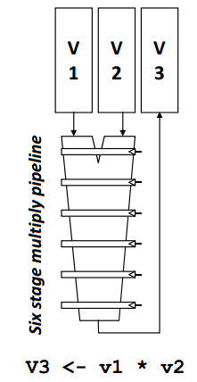
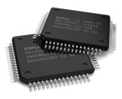
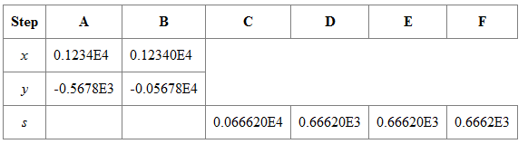

Floating Point Computation (multi-stage)
Consider the 6 steps (stages) involved in a floating-point addition on a sequential machine with IEEE arithmetic hardware:
  exponents are compared for the smallest magnitude.
  exponents are equalized by shifting the significand smaller.
  the significands are added.
  the result of the addition is normalized.
  checks are made for floating-point exceptions such as overflow.
  rounding is performed.
A scalar implementation of adding two array of length n will require 6n steps
A pipeline implementation of adding two array of length n will require 6 + (n-1) steps
Some architectures provide a wider overlapping by chaining the pipelines.
Roughly speeking, a p-length vector computation on a given n-array needs n/p steps.
Depending on the architecture, pipeline processing applies to # operations (arith, logical).
Could you identify and explain other type of pipeline in a standard computation scheme ?
FP comp // Integer comp // Load // store // ….

Slide 11



The way to the computing unit
It is important to understand that the overall performance of a computing system depends on
several layers, which have different efficiencies. The peak performance of a machine mainly
refers to the speed of its computing unit(s). What you get is generally far from it, unless you
are a very talented programmer or your application is definitely gentle.
Even an optimal algorithm will run at a
fraction of the peak performance !!!
Before we calculate, we need data
Time-to-CPU could be long % flops
Memory space decreases with level
Shared use of memory slowdown
Synchronization and data exchange
Control flow (if, while, for, case, …)

Slide 12
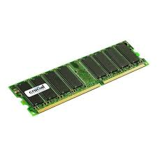
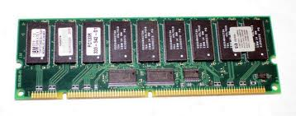
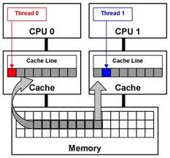

Memory structure
Memory is stored within the cache system in units known as cache lines (2^{k} contiguous bytes, k = 5 or 6 in general).
A memory address is said to be aligned if it is a multiple of the cache line length (important for performance).
Memory is multi-level. The typical hierarchy is from the main memory to the last-level cache (L1 cache), via intermediate level caches (L3 cache, L2 cache)
The cost to access data from a given memory level increases significantly from the last-level cache to the main memory. Having useful data at the last-level cache when needed is the key for maximum performances.
Any good programmer should be aware of this !!!
The so-called false sharing occurs when one variable located in the same cache line whose copies are hold by different cores is modified. Since that cache line will be systematically invalidated (even if not really necessary), the performance will suffer.
How can we aligned a memory allocation of N bytes starting at address p? Padding ?
How could we address the false sharing issue ?

Slide 13


Data alignment
Data alignment is important for performances and crucial in vector computing
Lack of knowledge about data alignment could raise the following issues
  Your software will run slower.
  Your application will lock up.
  Your operating system will crash.
  Your software will silently fail, yielding incorrect results.
Memory is accessed by chunks of constant sizes (cache line)
A memory address is said to be p-aligned iff it is a multiple of p (bits, default is size of the cache line)
It is important to also align the size of data types (padding if necessary).
Sometimes the compiler will automatically padd your data structures (check with sizeof())
There are specialized libraries for memory aligned allocations
typedef struct{char a; long b; char c;}mystruct; Is mystruct aligned ? How to fix it ?
Illustrate a misaligned memory address and explain some consequences ?
Write a C routine that implements aligned memory allocations ? Print addresses of a long array.

Slide 14
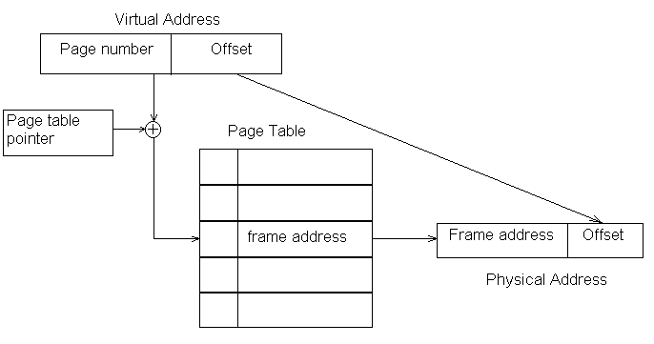
Memory addressing (Paging)
Introduce this way of addressing with urban addressing with/without city and street (only numero)
In a virtual memory system, the program memory is divided into fixed sized pages and allocated in fixed sized physical memory frames.
The pages do not have to be contiguous in memory.
Each virtual memory page is associated to one physical memory frame.
A page table keeps track of where each page is located in physical memory (address of its frame).
A memory frame can be on memory (resident) or on disk (in a page file (RAM image), .swp on Win).
Only actives pages need to be loaded. Unused pages can remain on disk until referenced.
Accessing a data on a frame that is on disk rather than on memory yields a page fault.
Thrashing occurs when the OS has to constantly swap back/forth between RAM and disk
With a sufficiently large RAM, page fault & thrashing are unlikely
The page table provides information
about the frames (address, location, modif, state)
Element | Length of the address | Size
Virtual Memory | a | 2ª
Physical Memory | b | 2^{b}
Page | c | 2^{c}
Can a program work with more than 2ª ?
Why b >> a ? What if we have a = b ?
Small page vs bigger page. Why if should be contigous ?
Who choose a, b, and c ? Explain.
How OS uses frames to avoid memory conflicts between processes ?

Slide 15


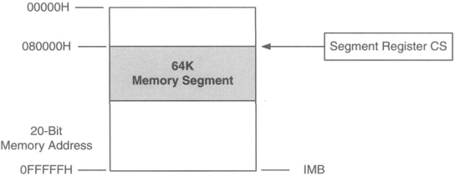
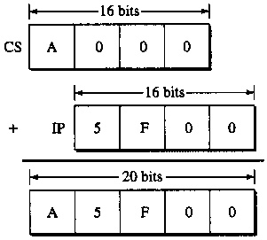
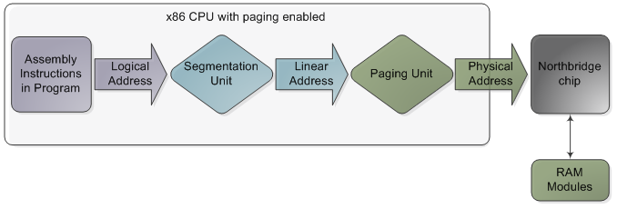
Memory addressing (Memory Segmentation)
In a memory segmentation system, the main memory is divided into segments or sections.
The logical address is a pair segment-id:offset (offset: position within the segment).
The segments do not have to be contiguous in memory and their position can change.
We still need to translate from logical address to physical address. Two modes.
The real mode (older, MS-DOS)
Only 1MB can be addressed (2²⁰, 20-bit address)
The effective size of a segment is at most 64 KB (we can use less, but not more for the same segment)
Both base (segment) and offset are 16-bit addresses ➢➢ 20-bit physical address
The 20-bit physical address is obtained by “adding” the (4-bit left shifted) base and the offset.
Code Segment Register
CS: Code (only CALL, JUMP)
DS, ES: Data
SS: Stack
Can we have segmentation and paging ?
What are the main drawbacks of the (native) real mode ?
Some OS can « switch to » real mode, why ?
Explain how the CS allows to use more than 64K. Why scaling ?
Could we use just of segment register ? Explain (stack,code data)
Out of 64 K for the last segment, addressing redundacy
Protected Mode Onluy !!!

Slide 16
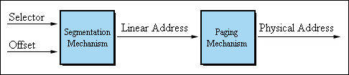
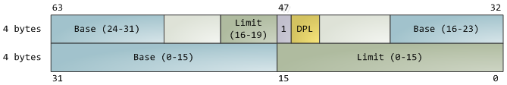


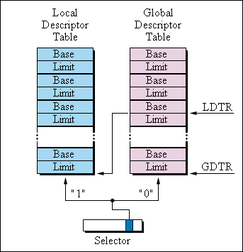
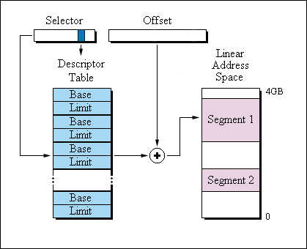
Memory addressing (Memory Segmentation)
The real mode (older, MS-DOS)
http://www.internals.com/articles/protmode/protmode.htm
The protected mode (modern and common)
More similar to the paging mechanism
The segment selector now contains an index into a table of segment descriptors.
base address is a 32-bit linear address (beginning of the segment)
limit specifies how big the segment is
DPL is the descriptor privilege level ∈⎨0,1,2,3⎬ (access control)
base address + logical memory address = linear address
8-bytes record describing a segment
gdtr register (per core) which stores the linear memory address of the first byte in the GDT
There are three types of segments: data, code and system.
Segment descriptors are stored in two tables: the Global Descriptor Table (GDT) and the Local Descriptor Table (LDT).
To choose a segment, you must load a segment register with a segment selector
segment_id within GDT
0 = GDT 1 = LDT
Requested Privilege Level
2-bytes segment selector
What is the size of the adressing space in protected mode ?
Are the segments of fixed or variable size?
Can segments overlap ?
What the LDT and GDT are used for ? LDT: Apps GDP: OS
How many LDT (resp.GDT) during a session ? Conflicts management ?
Do you understand the « segmentation fault » ?
(SDR) SDRAM, DDR (SDRAM), DDR2, eDRAM?

Slide 17


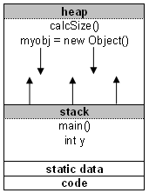
Stack & Heap
What is a stack?
Area of memory used for automatic variables, max size determined at program start-up
Data is stored in stack using the Last In First Out (LIFO) method
Storage in the memory is allocated /deallocated at only one end (top of the stack)
Can have a stack overflow when too much of the stack is used (increase stack max size)
Data created on the stack can be used without pointers and are destroyed at exit
What is a heap?
Area of memory used for dynamic memory allocation, “dynamic size” (reuses)
Blocks of memory are allocated and freed in this case in an arbitrary order
Can have a allocation failure when too big buffer is requested
Stack vs Heap
The stack is before runtime and heap is at runtime
The stack is much faster (allocation) and smaller (size) than the heap
On which factors depends the size of the stack ?
Pros ans cons of the stack.
Pros and cons of the heap.
Differences between int X[100]; and int x* = malloc(100*sizeof(int));

Slide 18
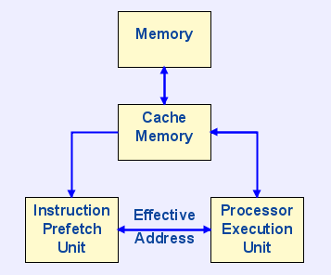
Cache memory
Introduce this with supermarket and shoops
What is it ?
A CPU cache is an intermediate memory between the main memory and the CPU
The cache is very small compare to the main memory, but is closer to the CPU
Access to the cache is faster compare to the main memory
Some machines have different levels of cache
How does it works
Data are transferred between memory and cache in blocks of fixed size (cache lines).
Each time the CPU needs to read/write in main memory, it first check in the cache
In case what we are looking for is in the cache, we get it from there: cache hit
Otherwise, we go to main memory and get the cache line into the cache: cache miss
When there are several levels of cache, some steps occur between consecutive levels
Cache policies
Making room for the new entry (on a cache miss), require to evict one of the existing entries
There are different policies for cache replacement
A good replacement policy should match good predictions
The least-recently used (LRU) policy is the most popular
What the programmer can do to take a good advantage of the cache ?
Why different levels of cache ?
Does the cache concerned about data only (not the instructions) ?
What do you think about “prefetch” instructions ?
Could you imagine other replacement policies ?

Slide 19
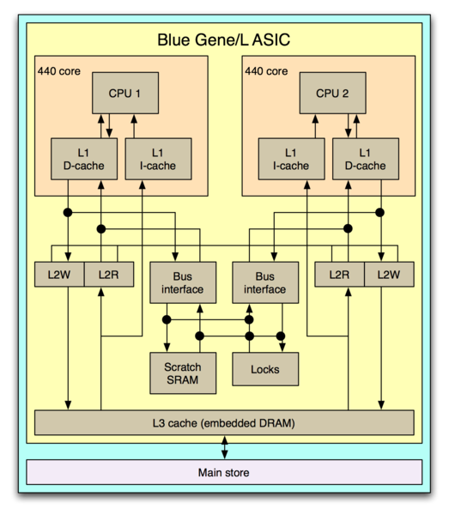
Case study
What main information do you get from this schema ?

Slide 20
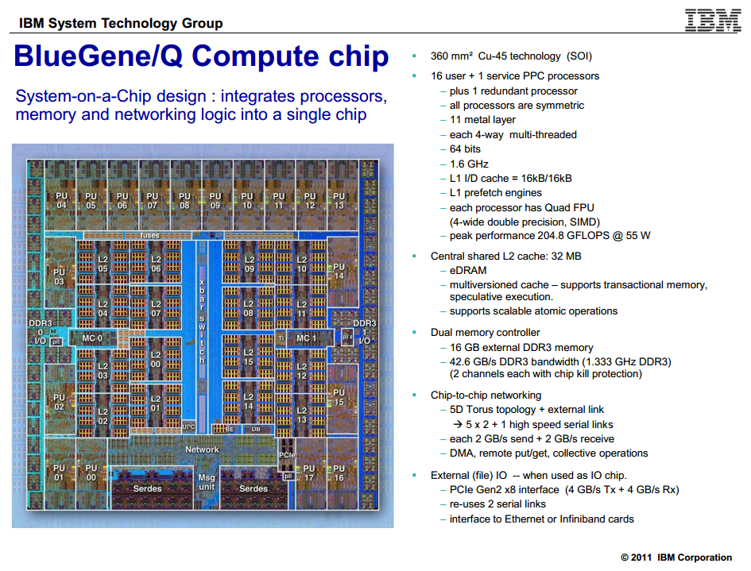
Case study
http://www.cpuid.com/softwares/cpu-z.html
What information do you get from this specification sheet ?

Slide 21
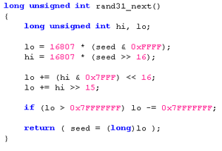



Assembly Language
Source code
Compiler
Programming
Assembly code
Programming
Programmer & Computer
Execution
Compiler
Binary code

Slide 22
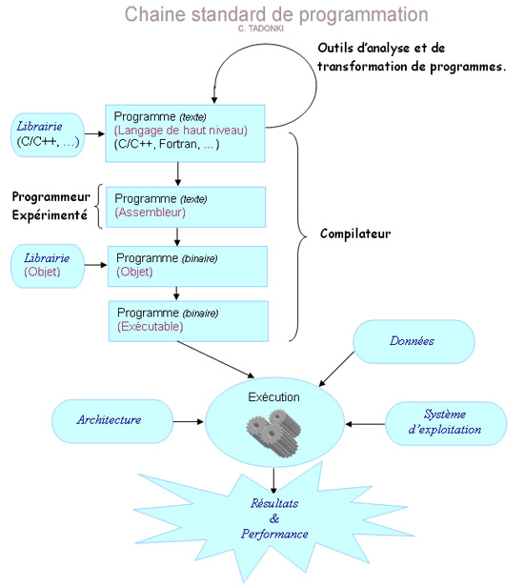
Assembly Language

Slide 23
Assembly Language
Overview
Assembly code is the penultimate form of a program before the object/binary form.
Assembly instructions have mostly direct 1:1 analog with machine (binary) instructions.
Assembly code is plain text, thus can be manually edited by the programmer.
The schedule of the instructions in the assembly code is preserved in the binary code.
There are several “assemblers” (assembler to binary translators): A86/A386, ACK, FASM, TASM, WASM, YASM
You can do things in assembly which are difficult or impossible in high level languages.
Programming aspects
Programming directly in assembler is a tedious task, but could lead to optimized code.
A deep knowledge of the target architecture is crucial to get an optimal assembly code.
An assembly code can be designed from scratch or from a draft generated by the compiler using appropriate compiling option from the source code.
Assembly codes are likely to have the .s or .asm extension.
gcc –S myprog.c will generate the corresponding assembly code myprog.s
Some parts of a C code can we written in assembly, we say “inline assembly”

Slide 24
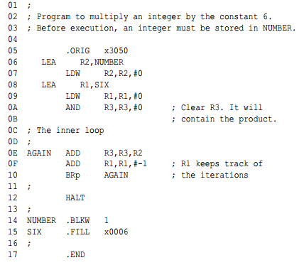
Structure of an assembly code
An assembly code is composed of directives (probably) acting on registers or memory
The overview structure of an assembly code displays three parts
  stack segment
  data segment
  code segment
We will mainly focus on the code segment, which contains the active instructions
The generic assembly line is as follows
LABEL OPCODE OPERANDS ; COMMENTS
http://www.cpuid.com/softwares/cpu-z.html

Slide 25
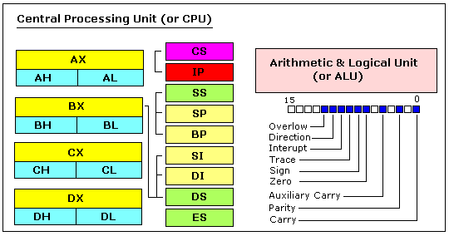
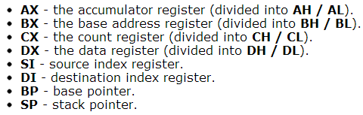

8086 Assembler
Registers (8086 CPU)
General purpose registers
These are 16 bit registers.
The four registers AX, BX, CX, DX are made of two separate 8 bit registers referenced with H (high) or L (low).
Despite the name of a register, it's the programmer who determines the usage for each general purpose register.
The main purpose of a register is to keep a number (variable).
Segment registers
Segment registers work together with general purpose register to access any memory value.
Example: To access memory address 12345h, we set DS = 1230h and SI = 0045h (1230h * 10h + 45h = 12345h).
CPU calculates physical address by multiplying the segment register by 10h and adding general purpose.
The address formed with 2 registers is called an effective address
By default BX, SI and DI registers work with DS segment register; BP and SP work with SS segment register.
Special purpose registers
IP register always works together with CS segment register and it points to currently executing instruction.
Flags Register is modified automatically by CPU after arithmetical operations (type of the result and switch).
Generally you cannot access these registers directly.

Slide 26
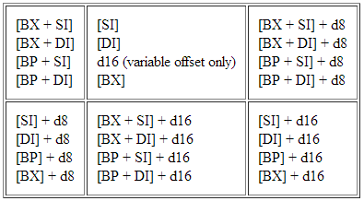

8086 Assembler
Memory Access
To access memory we can use these four registers: BX, SI, DI, BP
Adding these registers together inside [ ] and a displacement yield memory addresses
d8 (resp. d16) stands for 8 bit (resp. 16 bit) displacement. The appropriate type for d is machine dependent.
Displacement can be immediate value, variable, or a combination of both, and is a signed value (thus >0 or <0).
registers are added inside [ ], but there is no such syntax constraint for adding a displacement.
Example: Recall that DS points at the segment where variables are defined and the way an address is calculated.
For example, let's assume that DS = 150, BX = 40, SI = 75. (decimal notation)
The following addressing mode: [BX + SI] + 50
is calculated by processor to this physical address: 150 * 16 + 40 + 75 + 50 = 2565
Why using a register to keep or manipulate and address ?
SS is the base associated with BP, otherwise DS is the base (in all modes).
You can form all valid combinations using this regular expression
(CS, DS, SS, ES) is "segment“ and (BX, SI, DI, BP) is "offset".

Slide 27
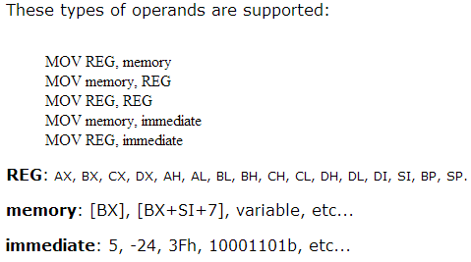
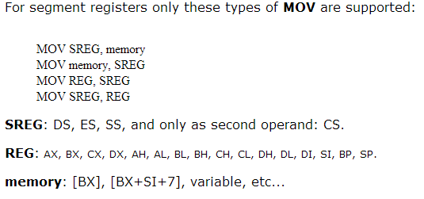
8086 Assembler
MOV instruction
The MOV instruction is use to move data/value from/to memory/register
MOV destination source
Copies the second operand (source) to the first operand (destination).
The source operand can be an immediate value, general-purpose register or memory location.
The destination register can be a general-purpose register, or memory location.
Both operands must be the same size, which can be a byte or a word (2 bytes)
The MOV instruction cannot be used to set the value of the CS and IP registers.

Slide 28
8086 Assembler
MOV instruction
Explain each MOV instruction in the follow code
MOV AX, 0B800h ; set AX to hexadecimal value of B800h.
MOV DS, AX ; copy value of AX to DS.
MOV CL, 'A' ; set CL to ASCII code of 'A', it is 41h.
MOV CH, 01011111b ; set CH to binary value 01011111.
MOV BX, 15Eh ; set BX to 15Eh.
MOV [BX], CX ; copy contents of CX to memory at B800:015E
Note: [register] means memory location with address DS:register_content

Slide 29
8086 Assembler
Variables
Variable is a memory location. It can be referenced by an address or a literal name.
Syntax for a variable declaration:
[name] DB/DW [value]
DB = Byte and DW = Word (2 bytes)
name is any letter or digit combination starting with a letter (optional)
value is any numeric value (hexadecimal, binary, or decimal) or ?
Examples:
X20 DB 8
Y2X DW 1234h
Variable can be an operand of the MOV instruction (will be replaced by its offset by the compiler)
Array
Arrays can be seen as chains of variables
Examples:
str1 DB 48h, 65h, 6Ch, 6Ch, 6Fh, 00h
str2 DB 'Hello', 0
Elements in array are accessed using brackets and index (value or index register)
Examples:
MOV AH, v[5]
MOV SI, 5
MOV AH, v[SI]
Examples:
LEA BX, VAR1
MOV BX, OFFSET VAR1
MOV BYTE PTR [BX], 40h
Getting the address of a variable
LEA destination variable
LEA (Load Effective Address)

Slide 30
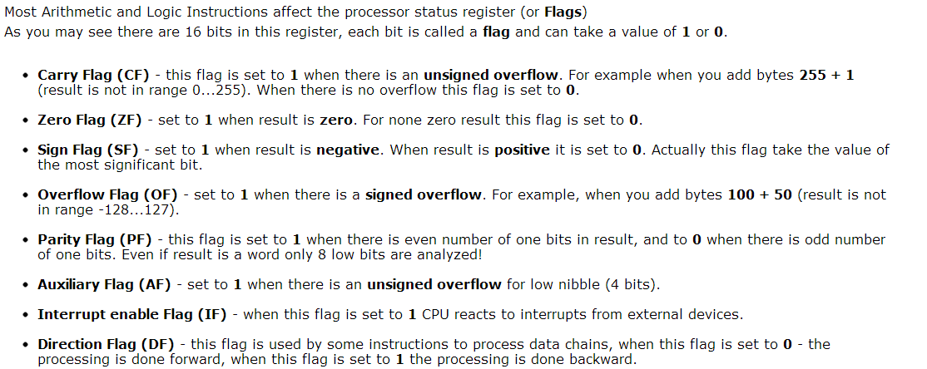
8086 Assembler
Arithmetic instructions
ADD, SUB,CMP, AND, TEST, OR, XOR
OP operand1 operand2
REG, memory / memory, REG / REG, REG / memory, immediate / REG, immediate
After operation between operands, result is always stored in first operand.
CMP (SUB) and TEST (AND) instructions affect flags only and do not store a result
MUL, IMUL, DIV, IDIV
REG, memory
INC, DEC, NOT, NEG
REG, memory

Slide 31
Some examples of assembly code
Code:
start:
mov ecx, 10 // The counter is in ECX
mov eax, 0 // I use EAX as a sum holder
myloop:
add eax, ecx // eax = eax + ecx
dec ecx // decrement the counter
cmp ecx, 0 // is ecx zero?
jne myloop // if not, then loop. If yes, then quit.
quit:
// here eax will hold the value of 1+2+...+10

Slide 32
Inline Assembly
Preliminary
a portion of assembler can be inserted into a standard C code (inline assembly). (advantage ?)
The syntax is not always the same (Intel syntax, AT&T syntax, …)
GNU C compiler for Linux uses AT&T syntax
asm("assembly code");
AT&T and Intel
Source-Destination Ordering: Intel ( opcode dst src) AT&T (opcode src dst)
Register naming: register names are prefixed by % (e.g: %eax, %ebx, …)
Immediat operand: Intel (no prefix, ‘h’ suffix for hex) AT&T (prefix ‘$’ suffix ‘x0’ for hex )
Operand size: Intel ( prefix mem ops) AT&T (opcode suffix ‘b’, ‘w’, ‘l’ for 1-2-4 bytes)
Memory operands: Intel ( base registers encore with ‘[]’) AT&T ( ‘()’)
asm ( assembly instructions
: output operands /* optional */
: input operands /* optional */
: list of clobbered registers /* optional */
);

Slide 33
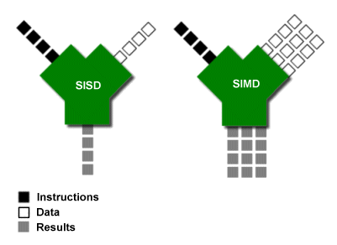
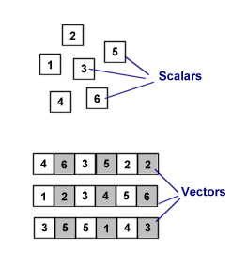
Vector Computing – SIMD (Single Instruction Multiple Data)
A SIMD machine simultaneously operates on tuples of atomic data (one instruction).
SIMD is opposed to SCALAR (the traditional mechanism).
SIMD is about exploiting parallelism in the data stream (DLP) , while superscalar SISD is about exploiting parallelism in the instruction stream (ILP).
SIMD is usually referred as VECTOR COMPUTING, since its basic unit is the vector.
Vectors are represented in what is called packed data format stored into vector registers.
On a given machine, the length of the vector registers and their number are fixed and determine the hardware SIMD potential.
SIMD can be implemented on using specific extensions MMX, SSE, AVX, …

Slide 34
Pipeline Floating Point Computation (multi-stage)
Consider the 6 steps (stages) involved in a floating-point addition on a sequential machine with IEEE arithmetic hardware:
  exponents are compared for the smallest magnitude.
  exponents are equalized by shifting the significand smaller.
  the significands are added.
  the result of the addition is normalized.
  checks are made for floating-point exceptions such as overflow.
  rounding is performed.
A scalar implementation of adding two array of length n will require 6n steps
A pipeline implementation of adding two array of length n will require 6 + (n-1) steps
Some architectures provide a wider overlapping by chaining the pipelines.
Roughly speeking, a p-length vector computation on a given n-array needs n/p steps.
Depending on the architecture, pipeline processing applies to # operations (arith, logical).
Pipeline feature is usually covered in the topic of Instruction Level Parallelism(ILP)
Could you identify and explain other type of pipeline in a standard computation scheme ?
FP comp // Integer comp // Load // store // ….

Slide 35
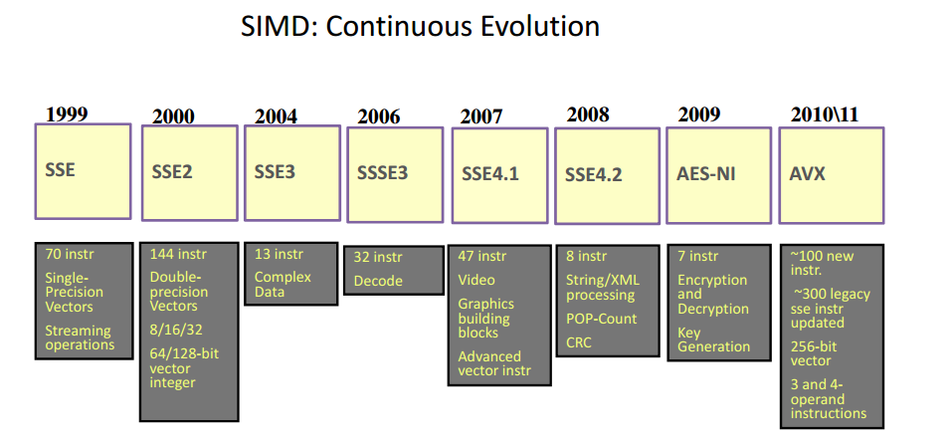
SIMD Implementation
Advanced Encryption Standard (AES)
AES New Instructions (AES-NI)

Slide 36
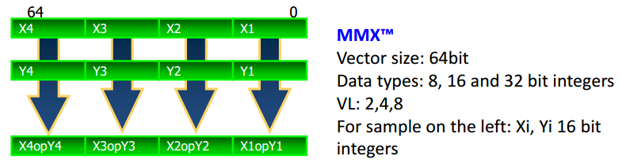
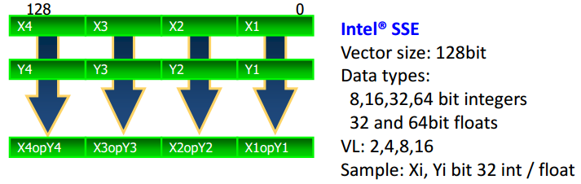
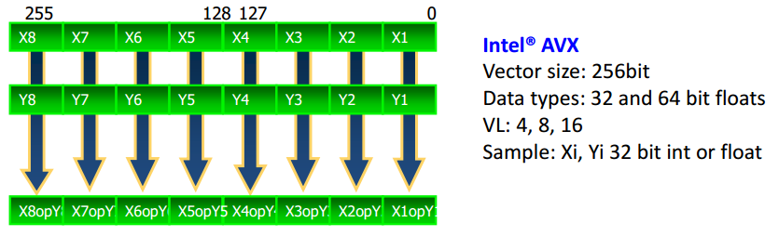
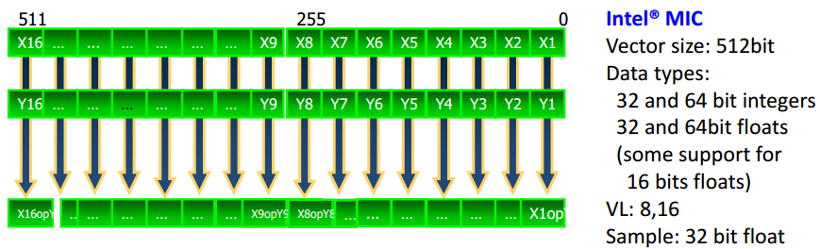
SIMD Implementation
MMX = MultiMedia eXtension
SSE = Streaming SIMD Extension
AVX = Advanced Vector Extensions
MIC = Many Integrated Core

Slide 37
SSE (Overview)
SSE = Streaming SIMD Extensions
SEE programming can be done either through (inline) assembly or from a high-level language (C and C++) using intrinsics.
The {x,e,p}mmintrin.h header file contains the declarations for the SSEx instructions intrinsics.
xmmintrin.h -> SSE
emmintrin.h -> SSE2
pmmintrin.h -> SSE3
SSEinstruction sets can be anabled or disabled. If disable, SSE instructions will not be possible. It is ecommended to leave this BIOS feature enabled by default. In any case MMX (MultiMedia eXtensions) will still avaiable.
compile your SSE code with "gcc -o vector vector.c -msse -msse2 -msse3“
SSE intrinsics use types __m128 (float) , __m128i (int, short, char), and __m128d (double)
Variable of type __m128, __m128i, and __m128d (exclusive use)
maps to the XMM[0-7] registers (128 bits), and automatically aligned on 16-byte boundaries.
Vector registers are xmm0, xmm1, …, xmm7. Initially, they could only be used for single
precision computation. Since SSE2, they can be used for any primitive data type.

Slide 38
SSE (Connecting vectors to scalar data)
Vector variables can be connected to scalar variables (arrays) using one of the following ways
float a[N] __attribute__((aligned(16)));
__m128 *ptr = (__m128*)a;
prt[i] or *(ptr+i) represents the vector
{a[4i], a[4i+1], a[4i+2], a[4i+3]}
float a[N] __attribute__((aligned(16)));
__m128 mm_a;
mm_a = _mm_load_pd(&a[4i]); // here we explicitly load data into the vector
mm_a represents the vector
{a[4i], a[4i+1], a[4i+2], a[4i+3]}
Using the above connection, we can now use SSE instruction to process our data.
This can be done through
(inline) assembly
intrinsics (interface to keep using high-level instructions to perform vector operations)
Pros and cons of using (inline)assembly versus intrinsics.

Slide 39
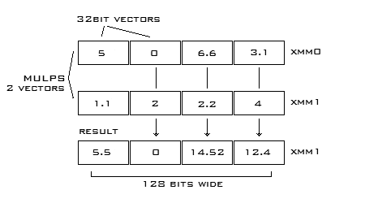
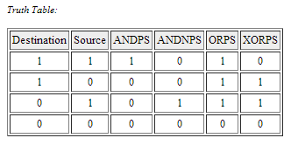
SSE (basic assembly instructions)
Data Movement Instructions
MOVUPS - Move 128bits of data to an SIMD register from memory or SIMD register. Unaligned.
MOVAPS - Move 128bits of data to an SIMD register from memory or SIMD register. Aligned.
MOVHPS - Move 64bits to upper bits of an SIMD register (high).
MOVLPS - Move 64bits to lower bits of an SIMD register (low).
MOVHLPS - Move upper 64bits of source register to the lower 64bits of destination register.
MOVLHPS - Move lower 64bits of source register to the upper 64bits of destination register.
MOVMSKPS - Move sign bits of each of the 4 packed scalars to an x86 integer register.
MOVSS - Move 32bits to an SIMD register from memory or SIMD register.
Arithmetic Instructions
Parallel Scalar (will perform the operation on the first elements only.)
ADDPS ADDSS - Adds operands
SUBPS SUBSS - Subtracts operands
MULPS MULSS - Multiplys operands
DIVPS DIVSS - Divides operands
SQRTPS SQRTSS - Square root of operand
MAXPS MAXSS - Maximum of operands
MINPS MINSS - Minimum of operands
RCPPS RCPSS - Reciprical of operand
RSQRTPS RSQRTSS - Reciprical of square root of operand
Logical Instructions
ANDPS - Bitwise AND of operands
ANDNPS - Bitwise AND NOT of operands
ORPS - Bitwise OR of operands
XORPS - Bitwise XOR of operands
http://neilkemp.us/src/sse_tutorial/sse_tutorial.html

Slide 40
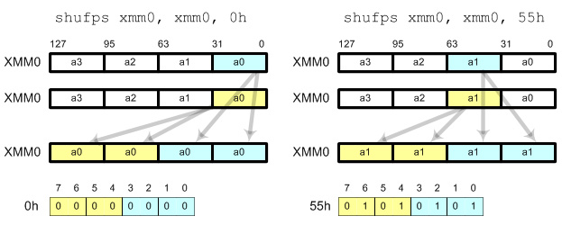
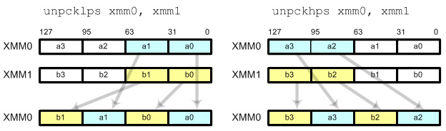
SSE (basic assembly instructions)
Shuffling offers a way to
  change the order of the elements within a single vector or
  combine the elements of two separate registers.
Shuffle Instructions
SHUFPS - Shuffle numbers from one operand to another or itself.
UNPCKHPS - Unpack high order numbers to an SIMD register.
UNPCKLPS - Unpack low order numbers to a SIMD register.
The SHUFPS instruction takes two SSE registers and an 8 bit hex value. (elements are numbered from right to left !!!)
The first two elements of the destination operand are overwritten by any two elements of the destination register.
The third and fourth elements of the destination register are overwritten by any two elements from the source register.
The hex string is used to tell the instruction which elements to shuffle.
00, 01, 10, and 11 are used to access elements within the registers.
Examples
SHUFPS XMM0, XMM0, 0x1B // 0x1B = 00 01 10 11 and reverses the order of the elements
SHUFPS XMM0, XMM0, 0xAA // 0xAA = 10 10 10 10 and sets all elements to the 3rd element
Write the suffling instruction to obtain (a2, a3, a0, a1) from (a3, a2, a1, a0) in XMM0
What is XMM0 after SHUFPS XMM0, XMM0, 93h ?
What is XMM0 after SHUFPS XMM0, XMM0, 39h ?
http://neilkemp.us/src/sse_tutorial/sse_tutorial.html

Slide 41
SSE (assembly examples)
// Use sse to multiply vector elements by a real number a * b
vector4 sse_vector4_multiply(const vector4 &op_a, const float &op_b)
{
vector4 ret_vector;
__m128 f = _mm_set1_ps(op_b); // Set all 4 elements to op_b
__asm
{
MOV EAX, op_a // Load pointer into CPU reg
MOVUPS XMM0, [EAX] // Move the vectors to SSE regs
MULPS XMM0, f // Multiply elements
MOVUPS [ret_vector], XMM0 // Save the return vector
}
return ret_vector;
}
struct vector4
{
float x, y, z, w;
};
// Use sse to add the elements of two vectors a + b
vector4 sse_vector4_add(const vector4 &op_a, const vector4 &op_b)
{
vector4 ret_vector;
__asm
{
MOV EAX, op_a // Load pointers into CPU regs
MOV EBX, op_b
MOVUPS XMM0, [EAX] // Move the vectors to SSE regs
MOVUPS XMM1, [EBX]
ADDPS XMM0, XMM1 // Add elements
MOVUPS [ret_vector], XMM0 // Save the return vector
}
return ret_vector;
}

Slide 42
SSE (assembly examples)
We need to write a SSE code to calculate the cross product
R.x = A.y * B.z - A.z * B.y
R.y = A.z * B.x - A.x * B.z
R.z = A.x * B.y - A.y * B.x
Complete the following code
// Use sse to add the elements of two vectors a + b
vector4 sse_vector4_cross_product(const vector4 &op_a, const vector4 &op_b){
vector4 ret_vector;
__asm
{
MOV EAX, op_a // Load pointers into CPU regs
MOV EBX, op_b
MOVUPS XMM0, [EAX] // Move the vectors to SSE regs
MOVUPS XMM1, [EBX]
MOVUPS [ret_vector], XMM0 // Save the return vector
}
return ret_vector;
}

Slide 43
SSE (assembly examples)
We need to write a SSE code to calculate the cross product
R.x = A.y * B.z - A.z * B.y
R.y = A.z * B.x - A.x * B.z
R.z = A.x * B.y - A.y * B.x
Complete the following code
// Use sse to add the elements of two vectors a + b
vector4 sse_vector4_cross_product(const vector4 &op_a, const vector4 &op_b){
vector4 ret_vector;
__asm
{
MOV EAX, op_a // Load pointers into CPU regs
MOV EBX, op_b
MOVUPS XMM0, [EAX] // Move the vectors to SSE regs
MOVUPS XMM1, [EBX]
MOVAPS XMM2, XMM0
MOVAPS XMM3, XMM1
SHUFPS XMM0, XMM0, 0xD8
SHUFPS XMM1, XMM1, 0xE1
MULPS XMM0, XMM1
SHUFPS XMM2, XMM2, 0xE1
SHUFPS XMM3, XMM3, 0xD8
MULPS XMM2, XMM3
SUBPS XMM0, XMM2
MOVUPS [ret_vector], XMM0 // Save the return vector
}
return ret_vector;
}

Slide 44
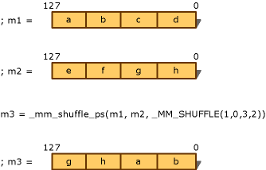
SSE (common intrinsics)
_mm_add_ps(__m128 a , __m128 b )
_mm_sub_ps(__m128 a , __m128 b )
_mm_mul_ps(__m128 a , __m128 b )
_mm_div_ps(__m128 a , __m128 b )
_mm_sqrt_ps(__m128 a , __m128 b )
_mm_min_ps(__m128 a , __m128 b )
_mm_max_ps(__m128 a , __m128 b )
_mm_cmpeq_ps(__m128 a , __m128 b )
_mm_cmplt_ps(__m128 a , __m128 b )
_mm_cmpgt_ps(__m128 a , __m128 b )
_mm_and_ps(__m128 a , __m128 b )
__mm_prefetch(&a[i], _MM_HINT_T0)
Pros and cons of the prefetch.

Slide 45

SSE (illustrations)
void scalar_sqrt(float *a){
int i;
for(i = 0; i < N; i++)
a[i] = sqrt(a[i]);
}
scalar
void sse_sqrt(float *a){
// We assume N % 4 == 0.
int nb_iters = N / 4;
__m128 *ptr = (__m128*)a;
int i;
for(i = 0; i < nb_iters; i++, ptr++, a += 4)
_mm_store_ps(a, _mm_sqrt_ps(*ptr));
}
SSE
10 times faster !!!!!!!

Slide 46
SSE (exercices)
Write the SSE loop equivalent to the following scalar loop (use vectors mm_d, mm_a, mm_b, mm_c).
for(i = 0; i < N; i++)
d[i] = (a[i] – b[i])*c[i];
for( i = 0; i <N; i+= 4){
mm_a = _mm_load_ps(&a[i]);
mm_b = _mm_load_ps(&b[i]);
mm_c = _mm_load_ps(&c[i]);
mm_r = _mm_add_ps( mm_a, mm_b );
mm_a = _mm_mul_ps( mm_r , mm_c );
_mm_store_ps( &r[i], mm_a );
}
Write the SSE loop equivalent to the following scalar loop (use vectors mm_c, mm_a, mm_b).
for(i = 0; i < N; i+= 2){
c[i] = (a[i] – b[i+1]);
c[i+1] = (a[i+1] – b[i]);
}
Write the SSE loop equivalent to the following scalar loop (typedef struct {float re; float im} complex;).
for(i = 0; i < N; i++) c[i] = multiply(a[i], b[i]);
Write the SSE loop equivalent to the following scalar loop
for(i = 0; i < N; i++) b[i] = 2*a[i] + 1;
Back to the cross product

